Slide 13
Private Passenger Automobile Insurance Landscape in Missouri
Jo LeDuc, Division Director, Insurance Market Regulation Division
Carrie Couch, Division Director, Insurance Consumer Affairs Division

Slide 14
Participants
Consumer
Insurance Agency
(Producer)
Insurance Company
Insurance Company

Slide 15
Insurance Companies
Affiliated Companies
Non-affiliated Companies

Slide 16
Insurance Company Reporting Estimates
2022 Financial Annual Statement
157 companies with positive "Other private passenger liability” premium in Missouri [line 19.2]
2022 Zip Code Data
Average exposures across each month in 2022 [total monthly exposures / 12]
85 of the 157 companies have more than 1,000 exposures
72 of the 157 companies have less than 1,000 exposures
20 of the 72 companies are a part of a group where at least one other company has more than 1,000 exposures
Estimate 52-72 companies qualify for alternative reporting

Slide 17
Insurance Consumer Affairs - Authority
Sections 374.085 and 374.190, RSMo grant DCI authority to investigate complaints to determine if there have been violations of insurance laws

Slide 18
Insurance Consumer Affairs Division
Includes the Consumer Services and Agent Investigations Section
Toll-free consumer hotline - 800-726-7390
Receives complaints and inquiries concerning insurance companies, insurance producers, and other licensees
Investigates complaints for compliance with insurance laws and policy provisions
Mediates complaints between consumer and insurer
Provides insurance education and outreach to Missouri consumers
On-site assistance during times of disaster and need

Slide 19
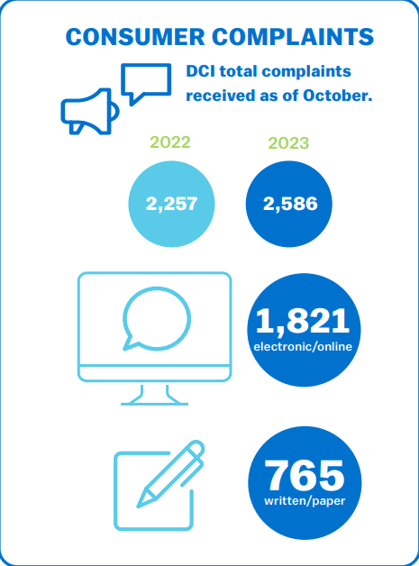
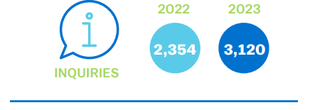
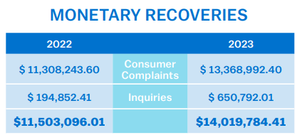
Insurance Consumer Affairs Stats (as of 10/31/23)

Slide 20
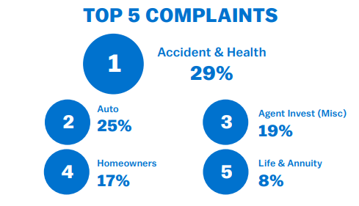
Insurance Consumer Affairs Complaints

Slide 21
Auto Complaints
Auto complaints and phone calls
Delays in adjusting claims/communication
Denial
Unsatisfactory settlement/offer
Rate increases

Slide 22
Auto Insurance Resources
Consumer Guide to Auto Insurance
Market Share Report
Consumer Complaint Index

Slide 23
Contact DCI
Carrie Couch, Director
Consumer Affairs Division
573-526-3407
Carrie.couch@insurance.mo.gov
Marjorie Thompson, Chief of Investigations
Agent Investigations, Consumer Affairs
573-751-1922
Marjorie.Thompson@insurance.mo.gov
Jeana Thomas, Consumer Services Manager
Consumer Affairs Division
573-751-2640
Jeana.Thomas@insurance.mo.gov
Insurance Consumer Hotline 800-726-7390 Insurance.mo.gov

Slide 24
24

Slide 26
